Slide 1
Scaling With CELERY

Slide 2
Agenda
* Recap - ( Asynchronous and Message Queue )
* Simple Task
* Scheduled, Beat Task
* Monitoring – Using Flower
* Group, Chain, Chord
* Queues
* Django Integration
* Flask Integration

Slide 3
Asynchronous Task
Asynchronous messaging is a communication model that relies on a store-and-forward technique.
In this technique, the sender doesn’t need a response from the recipient. This provides more flexibility and scalability as the senders and receivers are decoupled and are no longer required to execute in lockstep.

Slide 4
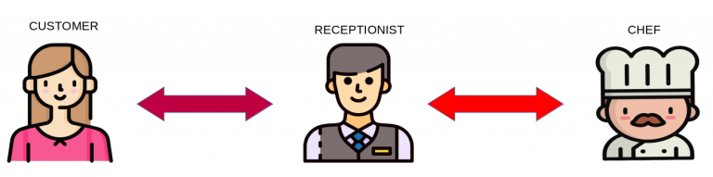
Asynchronous Task

Slide 5
Message Queue
A message queue is a form of asynchronous service-to-service communication used in serverless and microservices architectures.
Messages are stored on the queue until they are processed and deleted. Each message is processed only once, by a single consumer. Message queues can be used to decouple heavyweight processing, to buffer or batch work, and to smooth spiky workloads.

Slide 6
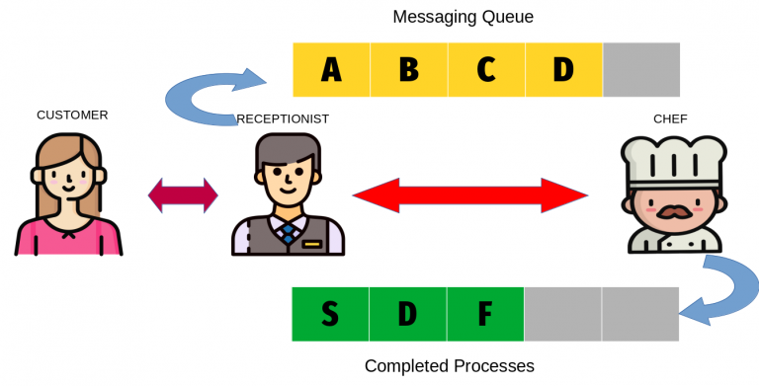
Message Queue

Slide 7
Celery
Celery is a task queue implementation for Python web applications used to asynchronously execute work outside the HTTP request-response cycle.
Task queues and the Celery implementation in particular are one of the trickier parts of a Python web application stack to understand.

Slide 8



Celery
All process will be running here
Heavy task request
WSGI
Response

Slide 9
Celery
All process will be running here
Heavy task request
WSGI

Slide 10

Celery
Heavy task request
WSGI
Worker
Message Broker

Slide 11
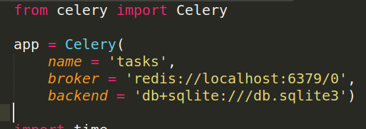
Celery – Simple Task
task registry
Tool Which maintains the message queue
Place where the results will get stored.

Slide 12
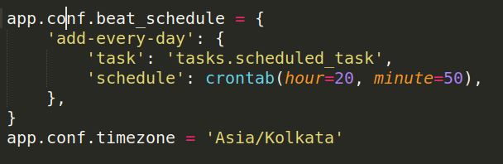
Scheduled Tasks
Module Name
Function name

Slide 13
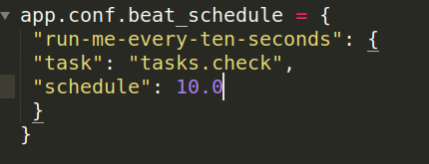
Beat Tasks
Module Name
Function name
For every y seconds

Slide 14
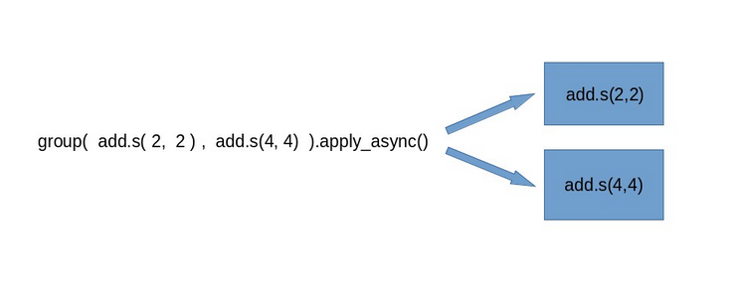
Group Tasks
Groups are used to execute tasks in parallel. The group function takes in a list of signatures.

Slide 15
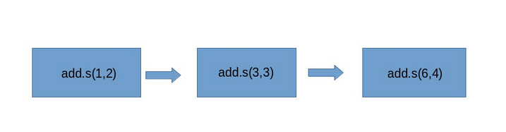
Chain Tasks
When we chain tasks together, the second task will take the results of the first task as its first argument

Slide 16
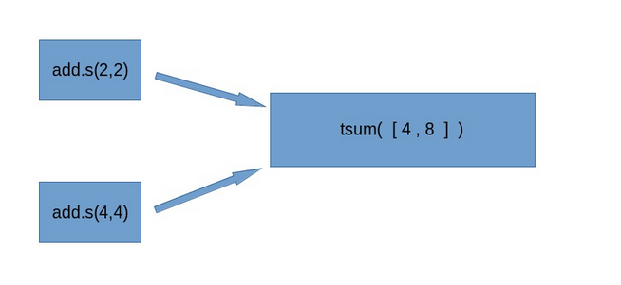
Chords Tasks
A Chord usually has two parts, header and callback
The header here is simply a group of tasks, the callback is run or executed after the groups of tasks have finished.

Slide 17
Chords Tasks
A Chord usually has two parts, header and callback
The header here is simply a group of tasks, the callback is run or executed after the groups of tasks have finished.

Slide 18
Queues
By default, Celery uses a single queue named celery. However, it is
possible to use multiple queues to spread the distribution of the tasks.
This feature makes it possible to have a more finely grained control over
the distribution of the jobs to execute.

